Slide 1

DOE Final Project
By Michael Giannattasio

Slide 2

Research Question
How to minimize patient staytime with different layouts and staffing counts?

Slide 3

Experimental Methodology
Tackling the problem using a factorial design

Slide 4

Why Factorial Designs (Why 2^k)?
Results of layout optimality for patient care are usually analyzed in 1-D settings
i.e. Which layout is better?
Does not analyze potential interaction effects with staffing
Resource availability and bottlenecking
Travel time importance discrepancies
Full factorial design allows for total comprehensive understanding of higher-level interactions
Provides more complete, real-world applicable recommendation
2^k Design
Factor screening
High number of factors considered while manageable data maintained
Allows for replicates (4 is adequate)

Slide 5


Literature Inspiration:
Wan, Hong, and Bruce E. Ankenman. "Two-stage controlled fractional factorial screening for simulation experiments." Journal of Quality Technology 39.2 (2007): 126-139.
Presents structure for fractional factorial designs with simulation and potential drawbacks
Overviews benefits of using simulations
Price, Time, Ease of Altering Factor Levels
Outlined methods for simulation combined with 2^k design to optimize clinical intervention
Averill M. Law. 2014. A tutorial on design of experiments for simulation modeling. In Proceedings of the 2014 Winter Simulation Conference (WSC '14). IEEE Press, 66–80.
Tutorial on combining DOE and DES
Kuhn, J., Sheldrick, R.C., Broder-Fingert, S. et al. Simulation and minimization: technical advances for factorial experiments designed to optimize clinical interventions. BMC Med Res Methodol 19, 239 (2019). https://doi.org/10.1186/s12874-019-0883-9

Slide 6
Literature Inspiration:
S. M. Sanchez, "Work Smarter, not Harder: Guidelines for Designing Simulation Experiments," Proceedings of the 2006 Winter Simulation Conference, Monterey, CA, USA, 2006, pp. 47-57, doi: 10.1109/WSC.2006.323037.
Gives best practices for intelligent design of a simulation for factorial experiments
R. C. H. Cheng and O. D. Jones, "Analysis of simulation factorial experiments by EDF resample statistics," 2000 Winter Simulation Conference Proceedings (Cat. No.00CH37165), Orlando, FL, USA, 2000, pp. 697-703 vol.1, doi: 10.1109/WSC.2000.899782.
Gives outline for using EDF statistics instead of ANOVA for nonnormally-distributed simulation results

Slide 7

Feasibility of Experiment
How to implement this factorial design?

Slide 8

Benefit of Simulation
Allows for hypothetical layout construction
Experimental validity:
Allows for randomness and near-normality:
Long runtimes
High replicates
Large Factor Levels
Automatic implementation
Cost- and Time- Effective
No significant ethical issues

Slide 9

Benefit of Simulation
Basically, only feasible with simulation
With FlexSim, the desired experimental structure is possible!

Slide 10

Data Collection

Slide 11
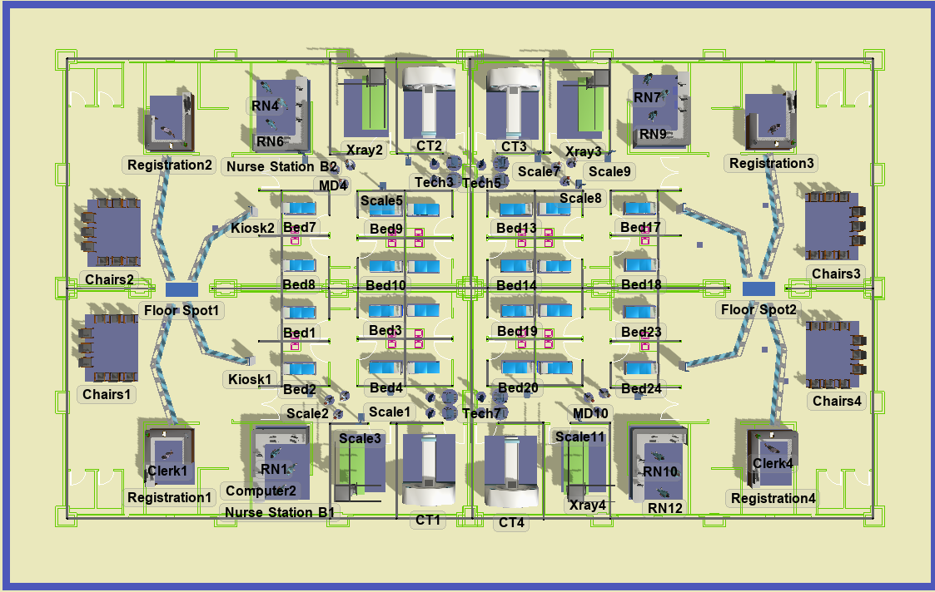
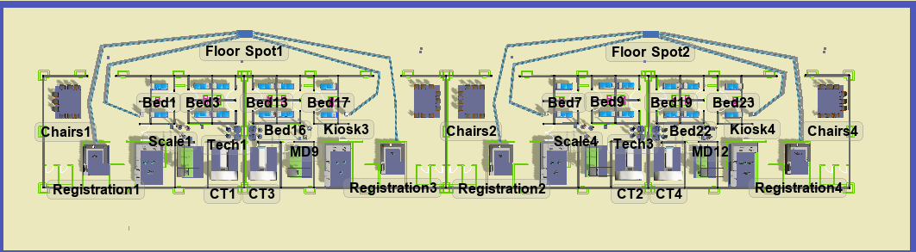
Two Hospital Layouts

Slide 12
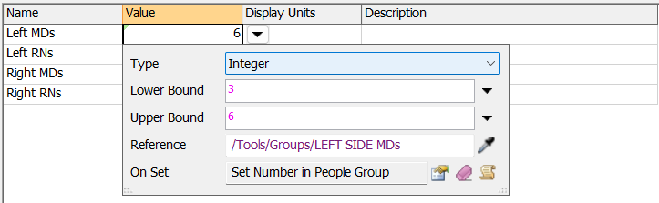
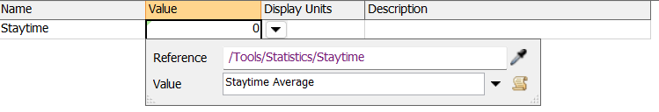
Parameter/Performance Measure Setup

Slide 13
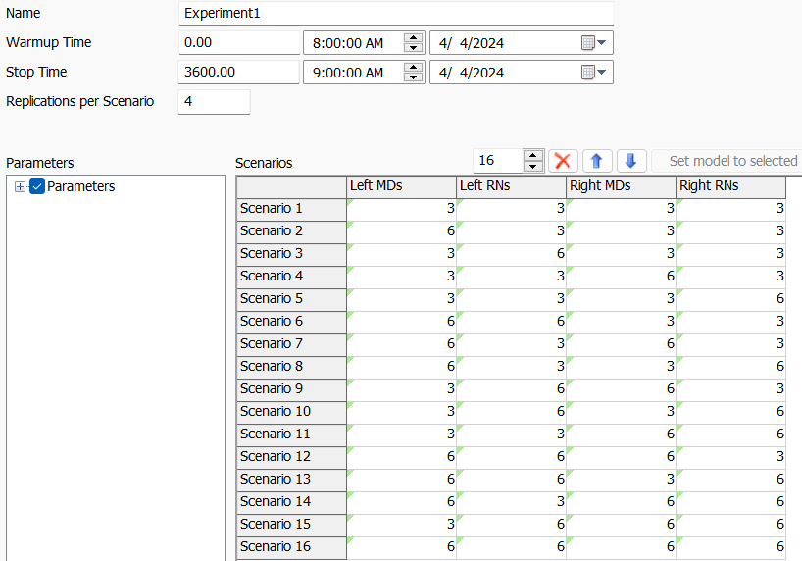
Experimenter Configuration

Slide 14
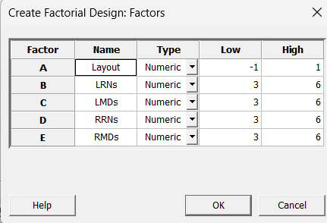
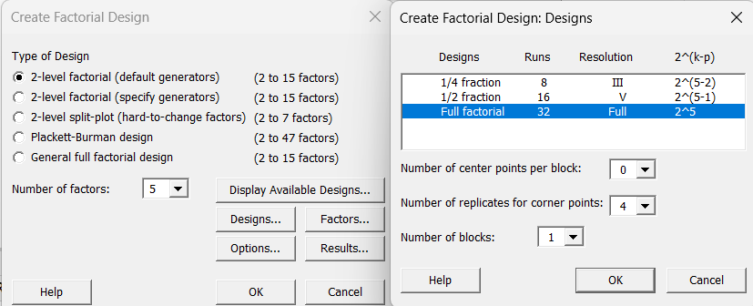
Experimenter Configuration
2^5 Factorial design chosen
Factor Screening
Consistent with Literature
Allows for reasonable data collection with replicates
Minitab/FlexSim both randomize data collection

Slide 15
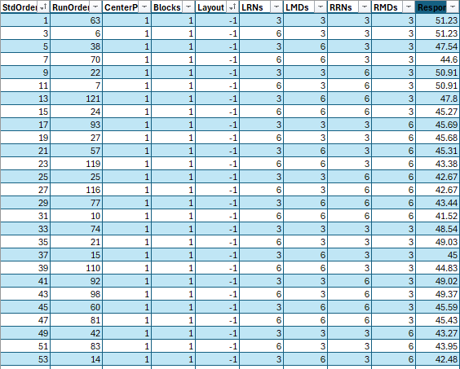
Data Sanitization:
Data sanitized in Excel

Slide 16

Statistical Analysis

Slide 17
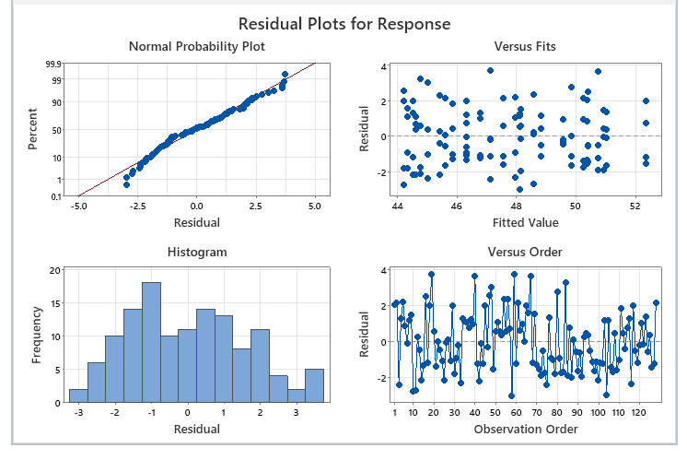
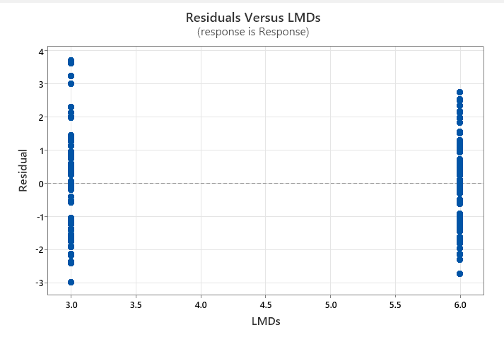
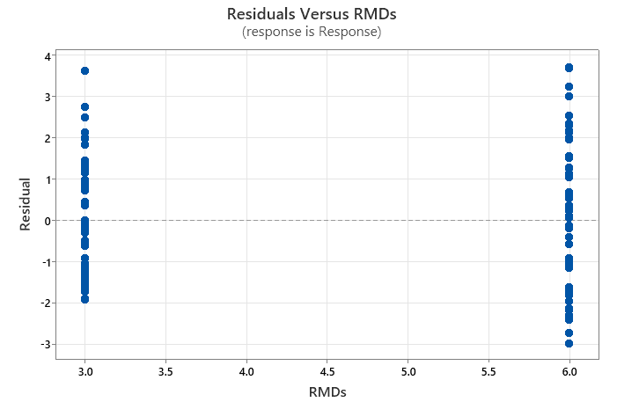
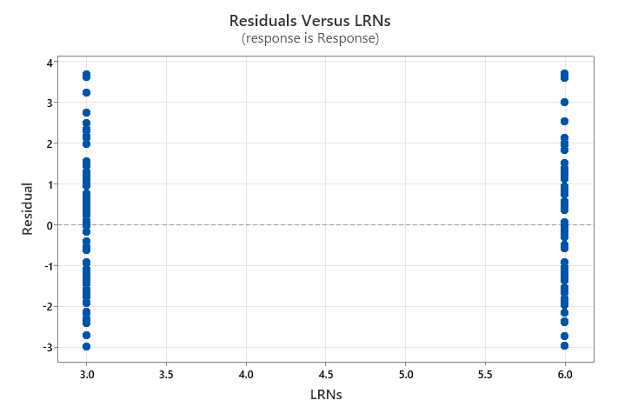
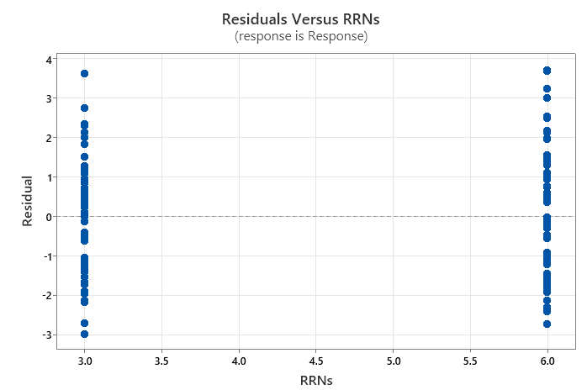
Model Assumptions:

Slide 18
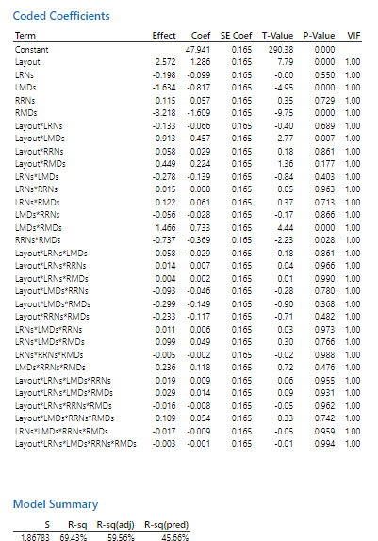
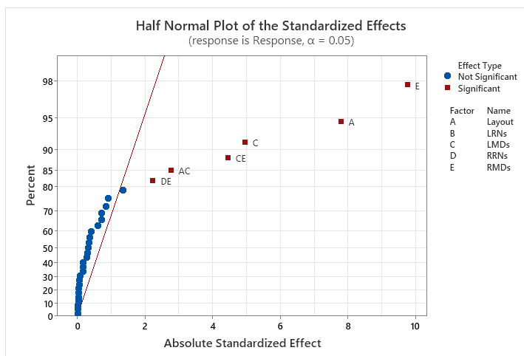
Original Model Results

Slide 19
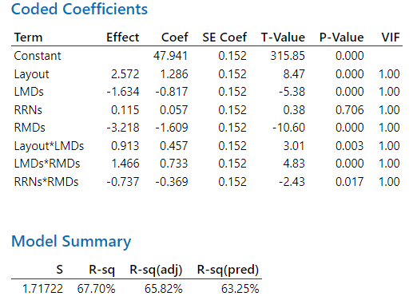
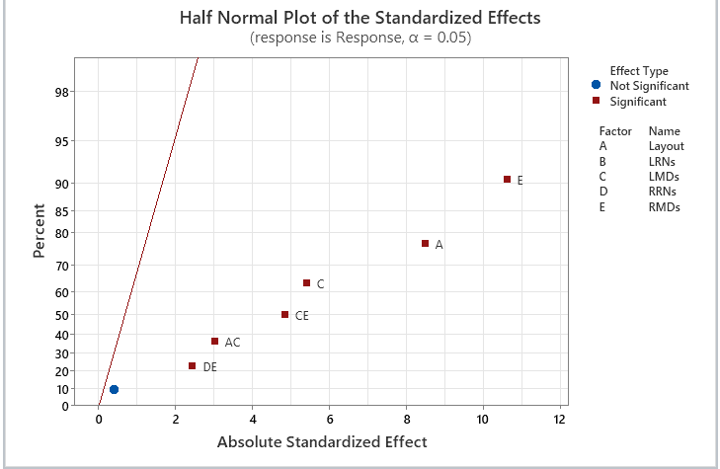
Reduced Model Results
Note:
Insignificant D (Right RNs) is maintained to keep model hierarchical
Adjusted and Predictive R-squared both increased

Slide 20
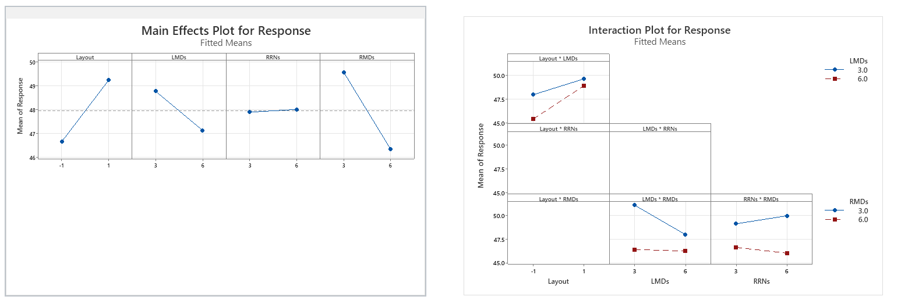
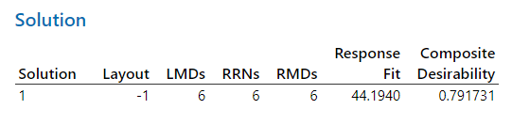
Factorial Plots & Results
Goal is to reduce staytime (minimzation)

Slide 21
Context-based Results
Despite optimization giving the best solution above
A cost-benefit analysis is important
L/RRNs treatment effects are not significant
RNs are incredibly expensive
Visualization shows no variability changes
"Optimal" values are 3

Slide 22

Implications
RMDs seem to be the system bottleneck in both systems
Largest effect size
Followed by layout then LMDs
Layout with proximity leads to lower patient staytimes
Significant interactions present
Layout and LMDs
LMDs and RMDs
RRNs and RMDs

Slide 23

Implications
While layout –1 had a significant reduction of staytime:
New layout should be designed to
Minimize MD travel time
Even at expense of RN travel time
Emphasis should be placed on MDs instead of RNs
Training to reduce process duration
Potential new hiring of staff

Slide 24
Drawbacks to Experimental Design
Only analyzed a limited number of operating factors
However, factor screening showed which are significant
Could be replicated without RNs, but with other procedural adjustment factors
Limited number of replicates
Still normality in data
Want to scale this up for validity in final advisement
Fractional factorial can be used to analyze effects with large data size
Limited number of layouts presented

Slide 25

Thanks for Listening!
And a special thanks to Arhum Shaikh for his contributions!

Slide 26
References
Wan, Hong, and Bruce E. Ankenman. "Two-stage controlled fractional factorial screening for simulation experiments." Journal of Quality Technology 39.2 (2007): 126-139.
Averill M. Law. 2014. A tutorial on design of experiments for simulation modeling. In Proceedings of the 2014 Winter Simulation Conference (WSC '14). IEEE Press, 66–80.
Kuhn, J., Sheldrick, R.C., Broder-Fingert, S. et al. Simulation and minimization: technical advances for factorial experiments designed to optimize clinical interventions. BMC Med Res Methodol 19, 239 (2019). https://doi.org/10.1186/s12874-019-0883-9
S. M. Sanchez, "Work Smarter, not Harder: Guidelines for Designing Simulation Experiments," Proceedings of the 2006 Winter Simulation Conference, Monterey, CA, USA, 2006, pp. 47-57, doi: 10.1109/WSC.2006.323037.
R. C. H. Cheng and O. D. Jones, "Analysis of simulation factorial experiments by EDF resample statistics," 2000 Winter Simulation Conference Proceedings (Cat. No.00CH37165), Orlando, FL, USA, 2000, pp. 697-703 vol.1, doi: 10.1109/WSC.2000.899782.

